Slide 1
FRD 24 Environmental Data Reporting Tool
Quick Reference Guide

Slide 2
Where to find the tool
Download the DEECA Environmental Data Reporting Tool from the Government Environmental Reporting Webpage:
https://www.climatechange.vic.gov.au/victorian-government-action-on-climate-change/government-environmental-reporting
Available on this page are:
Versions of the tool with emissions factors for the current and previous years.
A copy of this quick reference guide.
This tool has been developed for use by Victorian Government agencies for the purpose of complying with Financial Reporting Direction 24: Reporting of environmental data by government entities. It is not intended for use for other purposes.

Slide 3
How to get the best out of the tool
Don’t remove sheet or workbook protection – the tool may not function correctly if you do
Copy and paste data from other files directly into the worksheets – this will help reduce transcription errors
To compile data for previous years, use previous years’ versions of this tool so that the correct emissions factors will be used. Paste columns into your annual report to get a multi-year table
Please provide your finalised file to DEECA for incorporation into the WOVG emission inventory by email environmental.reporting@delwp.vic.gov.au This will help speed preparation of this information and reduce transcription errors

Slide 4
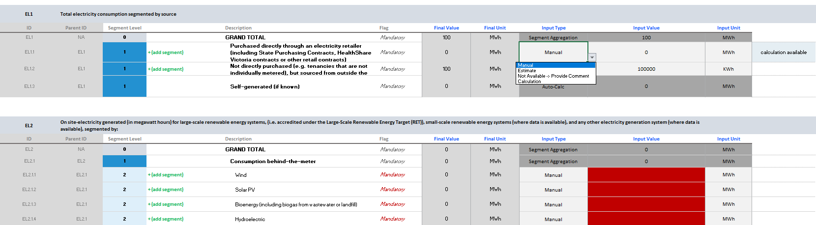
Common functions and how to input data
Segments can be added to enable data from different assets, activities, or billers to be added and aggregated. You can add descriptions to new segments. Multiple levels of segmentation can be used. Segments that are added can be deleted.
This dropdown box is for different input types.
Manual is for normal data entry
Estimate is the same as manual, but lets you flag the data as an estimate
Not available changes the input field to a text box, so you can add a note on the activity or data.
Calculation is used to select data that has been imported
Input data in these fields
Select input units using the dropdown box

Slide 5
Displayed information on data input sheets
Imported data is available for this indicator. You’re recommended to create an individual segment for the imported data so you can manually input data for other activities.
Displays whether an indicator is mandatory or optional based on the tier selected on the Home sheet
Displays the units required for this indicator under FRD 24
Indicator ID and name
IDs for indicator segments. These are not used outside of this tool.
Description of indicator segments in FRD 24 and the FRD 24 Guidance
Converted and aggregated data. Data cannot be entered in this field.
Rows in dark grey represent data either aggregated from the below segments, or automatically calculated from data entered elsewhere

Slide 6
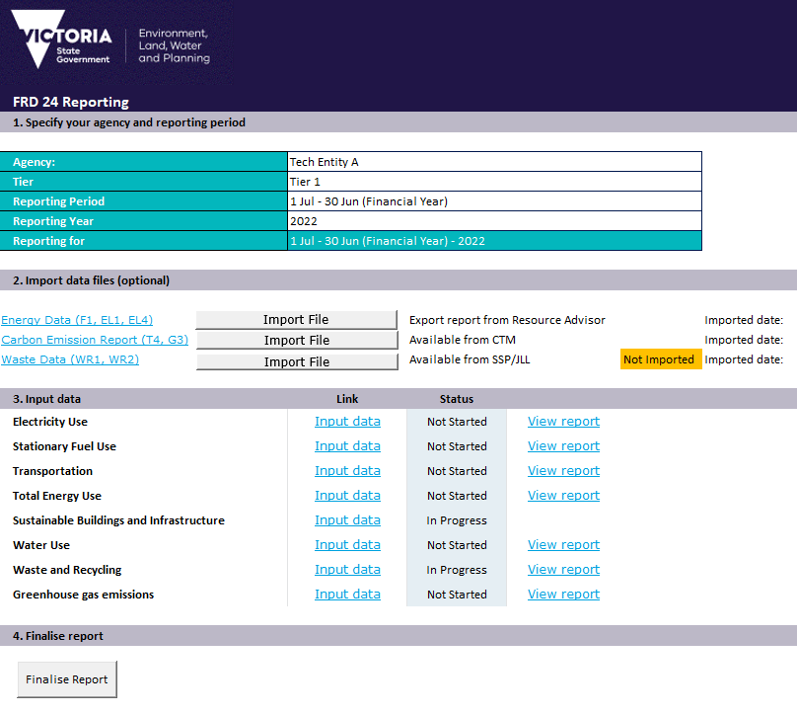
Using the Home sheet
Completing details in Section 1 will add these to output tables and files
Selecting your tier will display mandatory indicators on subsequent sheets
Section 2 allows the limited import of data
Data from the electricity SPC and large site gas SPC can be obtained from Resource Advisor. Corporate travel data can be obtained from CTM. Waste data from SSP/JLL managed offices can be obtained from JLL.
Section 3 has links to data entry sheets, displays whether mandatory indicators have had data entered, and links to formatted tables for your annual report
Data can be entered for the Sustainable Buildings and Infrastructure indicators, if you wish to provide that directly to DEECA – no export option is provided.
After you have finalised your report, you’re encouraged to provide your data to DEECA for compilation into the WOVG inventory. Please email the file to: Environmental.Reporting@delwp.vic.gov.au
Section 4 finalises and locks your report

Slide 7
Obtaining data for import
The Environmental Data Reporting Tool can import data from some limited sources:
Data for electricity (EL1) and GreenPower (EL4) used on the State Purchase Contracts, and gas consumption (F1) on the large-site gas State Purchase Contract, can be downloaded from the Resource Advisor platform.
Corporate air travel data including distance travelled (T4) and associated greenhouse gas emissions (G3) on the Travel Management Services State Purchase Contract can be obtained from CTM.
Waste collected from SSP/JLL managed office accommodation can be obtained from JLL.
The following pages outline how to obtain this data.

Slide 8
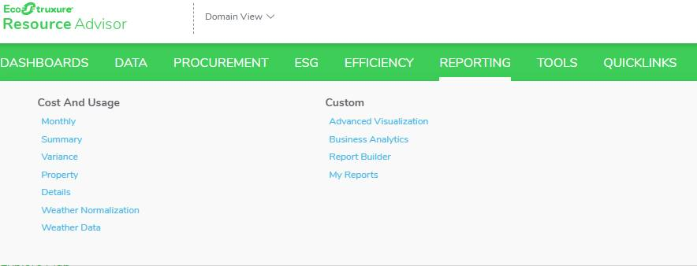
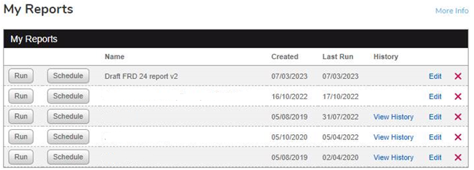
Downloading FRD 24 data from Resource Advisor
Login to Resource Advisor
Go to “Reporting” then “My Reports”
Find the FRD 24 report in “My Reports” and click the edit button

Slide 9
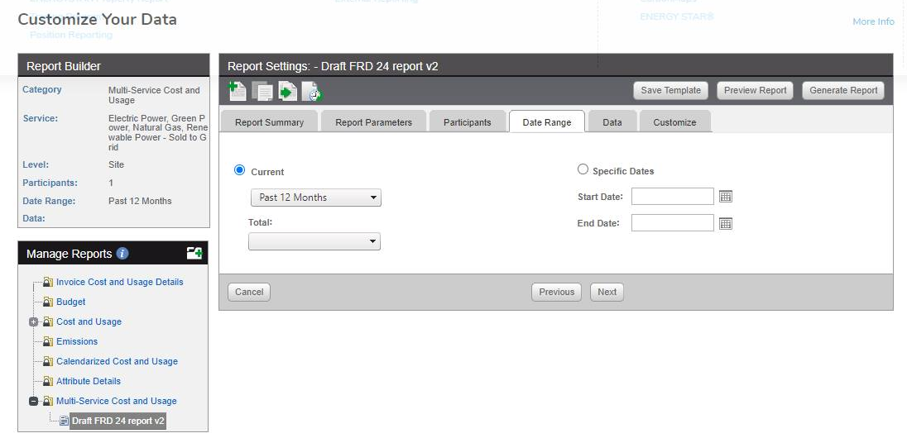
Downloading FRD 24 data from Resource Advisor
Specify the date range for your period of reporting and click “Generate Report”

Slide 10
Downloading FRD 24 data from Resource Advisor
Select “Excel” then click “Export”
Save the file on your computer
You can now import this file into the Environmental Data Reporting Tool.

Slide 11
Obtaining travel data from CTM and waste data from JLL
Obtaining travel data from CTM
Obtaining data from JLL
Request a “Carbon Emission Report” from CTM for the period for which you need data. Email CTM on connie.ivanoski@travelctm.com to obtain the report.
Request a “FRD 24 Waste Collection Report” from JLL. Email JLL on Rene.Hermon@jll.com to obtain the report.
Note that the report may contain sites for other departments, and shared sites. Ensure you remove sites for other organisations, and appropriately apportion shared sites to your organisation before importing.

Slide 12
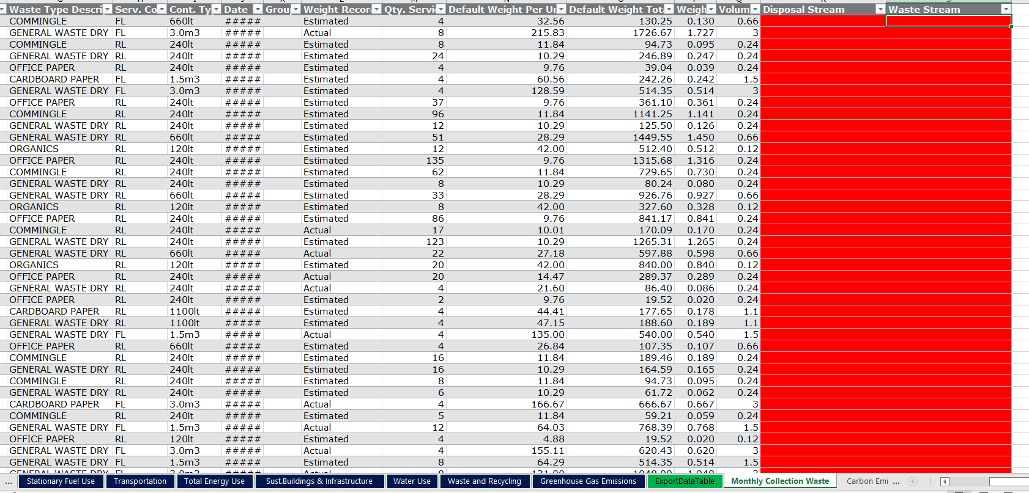
Additional steps required for importing waste data from JLL
Once you have imported waste data you need to map the disposal method and waste stream to be used in your reporting for each line item in the "Monthly Collection Waste" tab.
Use the drop down box to select the 'Disposal Stream', and type in your chosen 'Waste Stream' in the next column.
You can then use the same waste stream titles on added segments in the 'Waste and Recycling' tab to automatically sum the data.
See next page for an example

Slide 13
Additional steps required for importing waste data from JLL
Mapped disposal and waste streams
1. Map disposal and waste streams
3. Name the segments the same as in the ‘Monthly Collection Waste’ sheet
2. Add segments for relevant waste streams
4. Select ‘Calculation’ from the drop down menu

